Slide 1


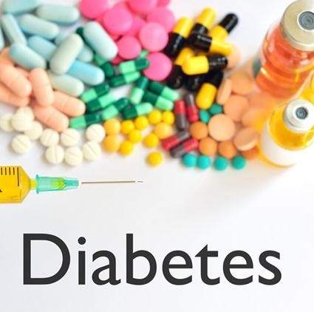
DIABETES DETECTION
SIC Capstone Project
Anish Kumar(1BG20IS077)
Avinash Rjendra Deshpande(1BG20IS011)
Sharath B (1BG20IS050)
Tarun Prabhu(1BG20IS059)

Slide 2
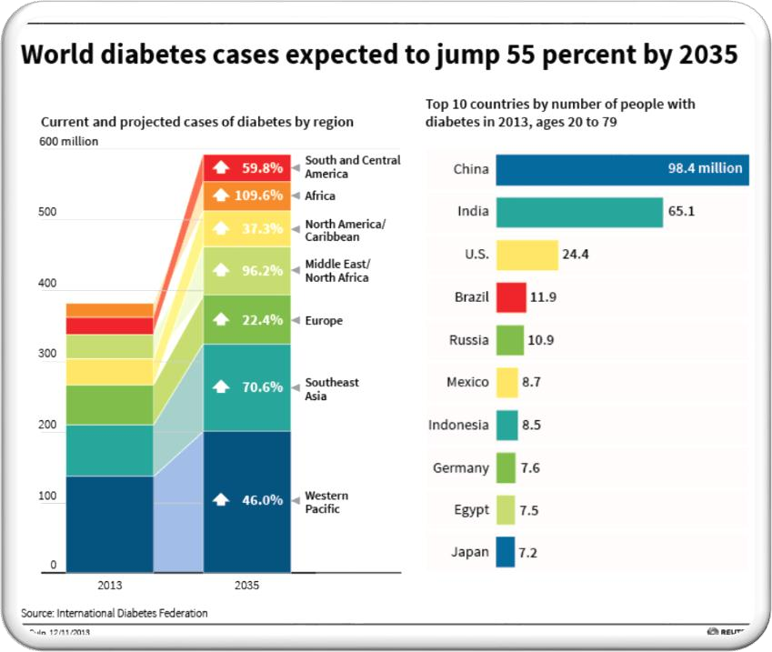
INTRODUCTION
🠶 Diabetes is one of the deadliest diseases in the world. It is
not only a disease but also creator of different kinds of
diseases like heart attack, blindness etc.
need
The normal to visit a
identifying process is that patients
diagnostic center, consult their doctor, and sit tight for a
day or more to get their reports.
🠶 Cause of Diabetes vary depending on the genetic makeup, family history, ethnicity, health etc.
🠶 Diabetes & pre-diabetes is diagnosed by blood test.

Slide 3
STANDARD PROCESS:CRISP DM
🠶 Crisp DM process is used to better understand the problem and give us better insight of whole process.
🠶 CRISP DM(Cross Industry Standard Process For Data Mining) has six phases:
1. Business/Research Understanding Phase
Determine the business objectives
To assess the problem and determine data mining goals
To come up with a strategy to meet goals and objectives
2. Data Understanding Phase
Collect the data
Assess and analyse the data

Slide 4
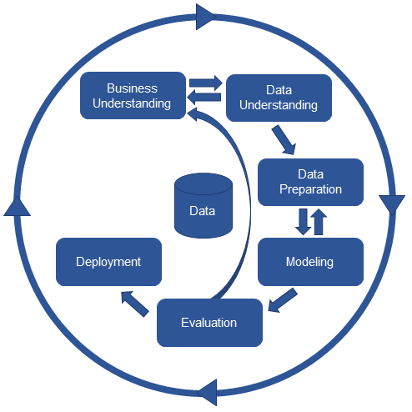
STANDARD PROCESS:CRISP DM
3. Data Preparation Phase
Clean the data i.e. remove any missing values or outliers etc.
Transform the data
Select specific data for analysis
4. Modeling
— Select appropriate data modeling technique
5. Evaluation
Evaluate the model
Calculate the accuracy and success rate of the model
6. Deployment
Plan deployment
Monitor Deployment
Generate reports to test success of the model

Slide 5
BUSINESS UNDERSTANDING
🠶 What is the profound question?
To identify whether the patient is having diabetes or not?
🠶 Goal
Goal of this project is to identify the probability of diabetes in patients using data mining techniques.
🠶 Advantage of this project
The rules derived will be helpful for doctors to identify patients suffering from diabetes. Further predicting the disease early leads to treating the patient before it becomes critical.

Slide 6
DATA UNDERSTANDING
🠶 Data Source
This dataset is originally from the National Institute of Diabetes and Digestive and Kidney Diseases. The objective is to predict based on diagnostic measurements whether a patient has diabetes or not.
This dataset has 769 samples of diabetic and healthy individuals.
In particular, all patients here are females of at least 21 years of age.
The diabetes dataset is credited to UCI machine learning database repository.

Slide 7
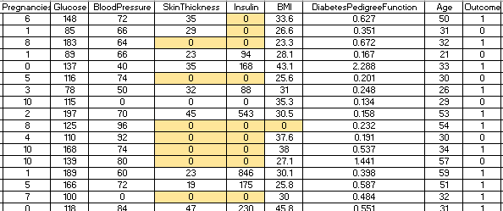
DATA UNDERSTANDING
🠶 Data Set Details:
The dataset consist of 769 samples, out of which 500 are non diabetic while 269 are diabetic people.
All patients are females of at least 21years of age.
The dataset has total 9 attributes out of which 8 are independent variables and one is the dependent variable i.e. target variable which determines whether patient is having diabetes or not.
🠶 Sample Data

Slide 8
DATA UNDERSTANDING
🠶 Attributes Details:
Pregnancies: No. of times pregnant
Glucose: Plasma Glucose Concentration a 2 hour in an oral glucose tolerance test (mg/dl)
Plasma Glucose Test | Normal | Prediabetes | Diabetes
2 hour post-prandial | Below 140 mg/dl | 140 to 199 mg/dl | 200 mg/dl or more
A 2-hour value between 140 and 200 mg/dL is called impaired glucose tolerance. This is called "pre- diabetes." It means you are at increased risk of developing diabetes over time. A glucose level of 200 mg/dL or higher is used to diagnose diabetes.
Blood Pressure: Diastolic Blood Pressure(mmHg)
If Diastolic B.P > 90 means High B.P (High Probability of Diabetes) Diastolic B.P < 60 means low B.P (Less Probability of Diabetes)

Slide 9
DATA UNDERSTANDING
🠶 Skin Thickness: Triceps Skin Fold Thickness (mm) –
A value used to estimate body fat. Normal Triceps Skinfold Thickness in women is 23mm.
Higher thickness leads to obesity and chances of diabetes increases.
🠶 Insulin: 2-Hour Serum Insulin (mu U/ml)
Feature | Normal Insulin Level
2 Hours After Glucose | 16-166 mIU/L
Values above this range can be alarming.
🠶 BMI: Body Mass Index (weight in kg/ height in m²)
Body Mass Index of 18.5 to 25 is within the normal range
BMI between 25 and 30 then it falls within the overweight range. A BMI of 30 or over falls within the obese range.

Slide 10
DATA UNDERSTANDING
🠶 Diabetes Pedigree Function:
It provides information about diabetes history in relatives and genetic relationship of those relatives with patients. Higher Pedigree Function means patient is more likely to have diabetes.
🠶 Age (in years)
🠶 Outcome:
Class Variable (0 or 1) where ‘0’ denotes patient is not having diabetes and ‘1’ denotes
patient having diabetes.
The dependent variable is whether the patient is having diabetes or not.

Slide 11
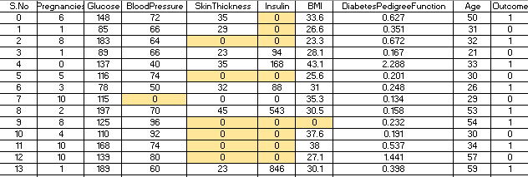
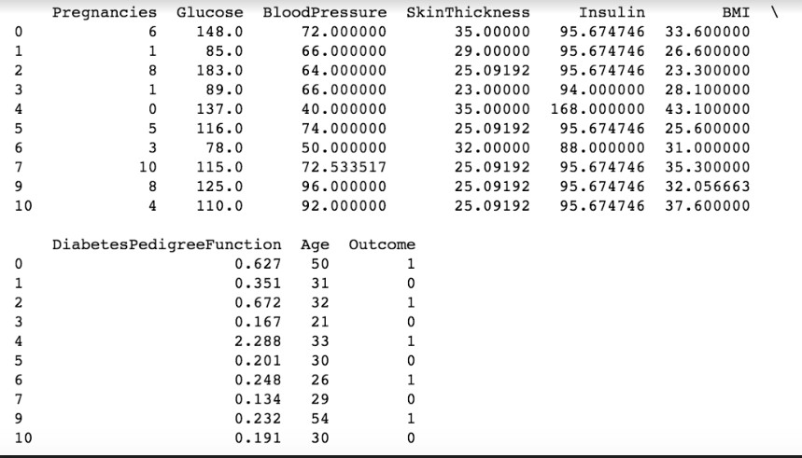
DATA PREPARATION
🠶 Data preparation stage includes data cleaning and transforming data if needed.
🠶 Various things have to be taken into consideration for data cleaning like:
Handling Zero/Null Values – The zeroes shown in the table are not zeroes but null values . We have deduced this based upon our inference that certain attributes like skin thickness, insulin, BMI etc cannot be zero.
The dataset had a lot of zero values.
The zero values have been replaced by the mean of that column.

Slide 12
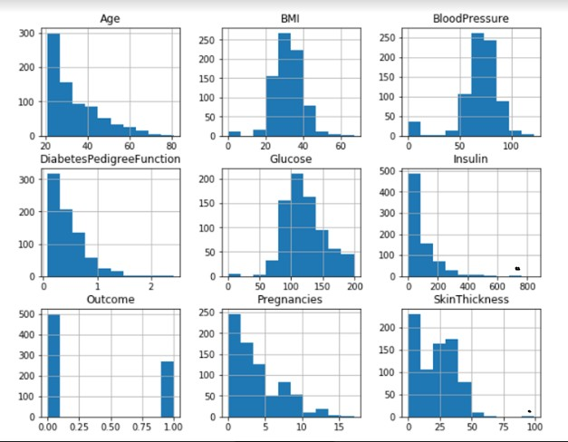
DATA PREPARATION
Check and remove outliers
This graph shows the distribution of dataset of different attributes. By carefully studying the graph we figured out that Insulin and Skin thickness graphs have outliers. The black dots depicts the outliers.

Slide 13
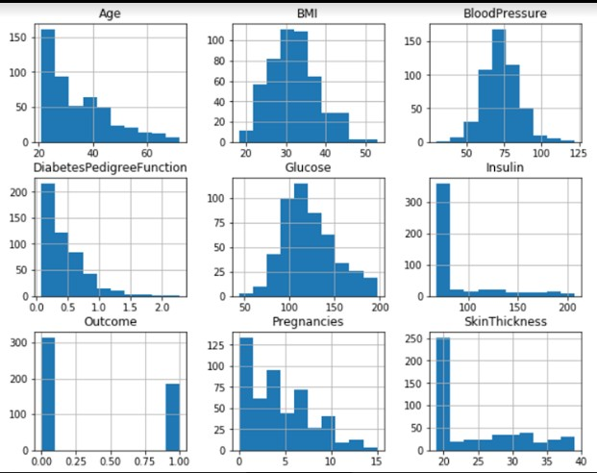
DATA PREPARATION
Outliers were found in Insulin and Skin Thickness attributes. They were removed using IQR (Inter Quartile Range) method.
Outliers Removed

Slide 14
DATA PREPARATION
🠶 Select appropriate attributes for analysis
The dataset consist of 9 attributes i.e. Pregnancies, Glucose, Blood Pressure, Diabetes Pedigree Function, Age, Skin Thickness, Insulin, BMI. These 8 are independent attributes and one i.e. Outcome is the dependent attribute.
As all these attributes affect diabetes so we decided to keep all the independent variables for data mining process.
🠶 Data Splitting:
Data was divided into training and testing data into 60:40 ratio. Sixty percent was training data and forty percent was testing data.
Out of 498 records after data cleaning, 298 records were used for trained and 200 records were used for testing.

Slide 15
DATA PREPARATION
🠶 Different ranges were found out for each continuous variable in the data set. Based upon these ranges categorization was done.
🠶 The features were categorized as per the below mentioned ranges and
were denoted by 0,1, 2 & 3, in order to use them for classification.
Glucose
Plasma Glucose Test | Normal | Prediabetes | Diabetes
2 hour post-prandial | Below 140 mg/dl (0) | 140 to 199 mg/dl (1) | 200 mg/dl or more (2)
Blood Pressure(Diastolic)
Ranges | Low | Normal | High
 | Below 60 (0) | 60-90 (1) | 90 or more (2)
Skin Thickness
Ranges | Low | Normal | High
 | <23 (0) | 23 (1) | >23 (2)

Slide 16
DATA PREPARATION
Insulin
Ranges | Low | Normal | High
2 Hours After Glucose | <16 mIU/L (0) | 16-166 mIU/L (1) | >166 mIU/L (2)
BMI(weight in kg/ height in m²)
Ranges | Under-weight | Normal | Over-weight | Obese
 | <18.5 (0) | 18.5-25 (1) | 25-30 (2) | >30 (3)
Diabetes Pedigree Function
 | Low | Medium | High
 | 0-0.78 (0) | 0.79-1.561 (1) | >1.57 (2)
Age
Ranges | Young | Adult | Old
 | 20-44 (0) | 44-64 (1) | 64-100 (2)
No.of Pregnancies
Ranges | Normal | Above Normal | Highest
 | <6 (0) | 6-12 (1) | >12 (2)

Slide 17
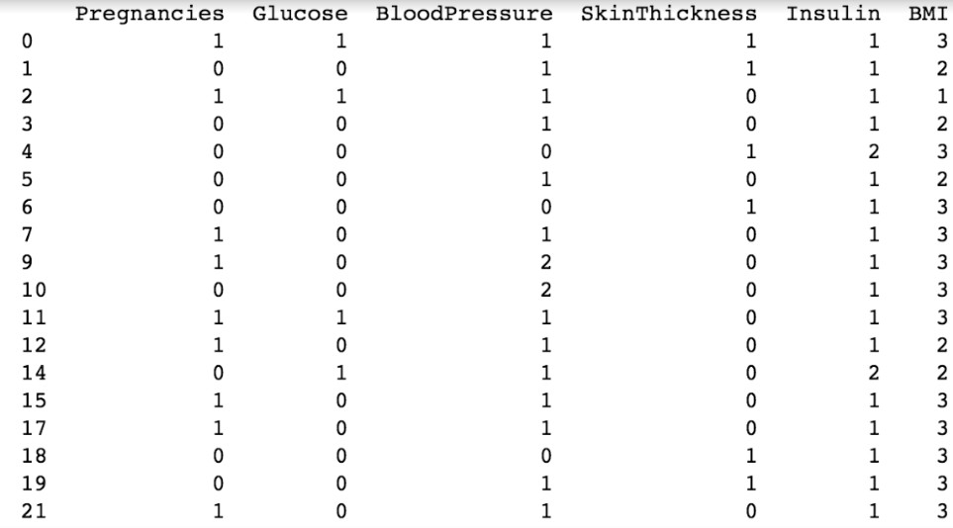
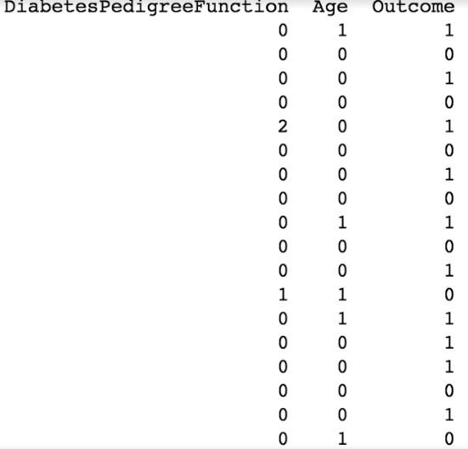
DATA PREPARATION
🠶 The tables shows the data after categorization. Different ranges taken for categorization of data are denoted by 0,1, 2 & 3.

Slide 18
MODELING
🠶 This phase includes application of appropriate model to the data.
🠶 Machine Learning Algorithms were used for modeling.
🠶 As we have to classify the data into patients having diabetes or not, we used Classification and Regression Tree Algorithm(CART) & K-Nearest Neighbor algorithms. Both of these algorithms are good for classifying dependent variables based upon categorized independent variables.
🠶 We compared both the algorithms to find the one which gives the best results
based upon overall accuracy and precision.

Slide 19
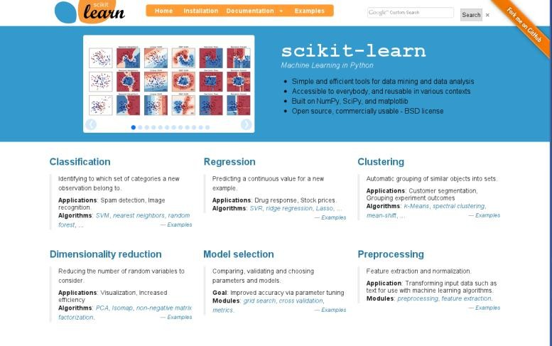
MODELING
🠶 Software Used:
Python-Scikit Learn
Scikit-learn provides a range of supervised and unsupervised learning algorithms via a consistent interface in Python.
🠶 The library is built upon the SciPy (Scientific Python) that must be installed before
we can use scikit-learn. This stack includes:
🠶 NumPy: Base n-dimensional array package
🠶 SciPy: Fundamental library for scientific computing
🠶 Matplotlib: Comprehensive 2D/3D plotting
🠶 IPython: Enhanced interactive console
🠶 Sympy: Symbolic mathematics
🠶 Pandas: Data structures and analysis

Slide 20
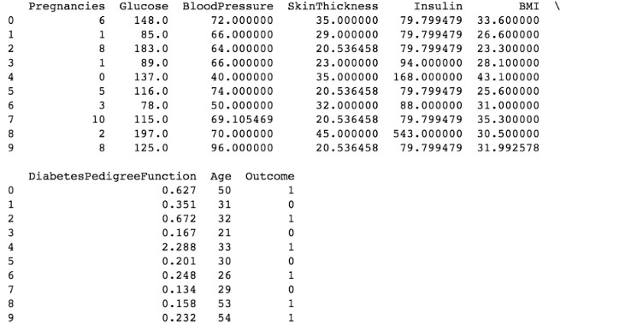
MODELING: USING PYTHON SCIKIT LEARN
🠶 The file containing data set is loaded in pandas.

Slide 21
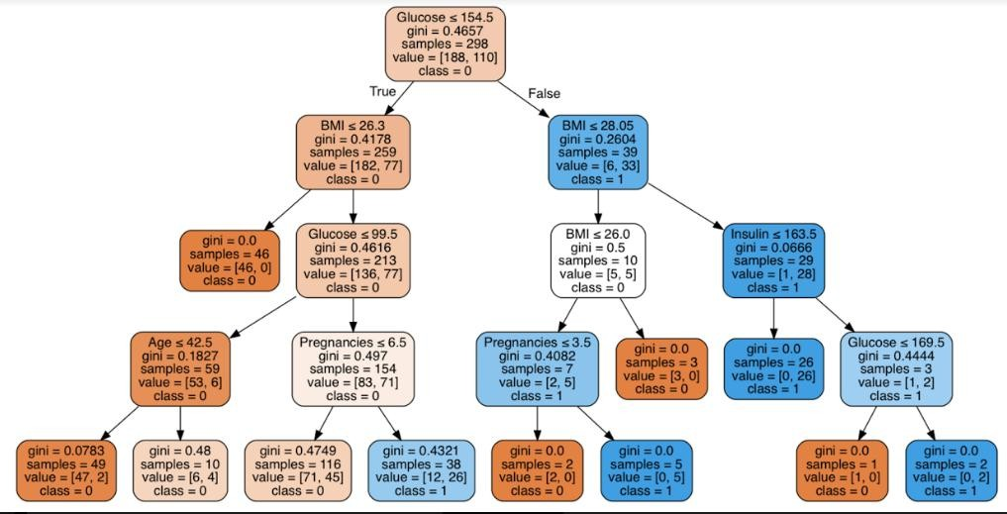
MODELING: USING PYTHON SCIKIT LEARN
🠶 The decision tree model i.e. CART is applied on the training dataset. The Decision Tree obtained gives the best result. The depth taken for this tree is 4 and total number of nodes are 21.

Slide 22

MODELING: USING PYTHON SCIKIT LEARN
Node Description:
🠶 The root node split in this tree started with Glucose attribute.
🠶 No of samples – It is the count of those samples whose glucose value is less than 154.5
🠶 Value – It gives the total no of samples for outcome ‘0’ and ‘1’. For e.g. in root node the
value 188 (represents class ‘0’) is higher than 110 (represents class ‘1’) , so this node is
classified as class ‘0’
🠶 Class – Diabetic – ‘1’ or Non Diabetic – ‘0’
🠶 Gini Impurity – This function measures the quality of a split. This factor measures how a randomly chosen element from the set would be incorrectly classified i.e. It is probability of misclassification of a record. It is used to minimize misclassifications.

Slide 23
MODELING: USING PYTHON SCIKIT LEARN
Decision Rules
S.No. | Antecedent | Consequent | Support | Confidence
1. | If Glucose<= 154.5 & BMI <= 26.3 | No Diabetes | 46/298 | 1
2. | If Glucose<= 154.5 & BMI <= 26.3 & Glucose <= 99.5 & Age <= 42.5 | No Diabetes | 47/298 | 0.95
3. | If Glucose<= 154.5 & BMI <= 26.3 & Glucose <= 99.5 & Age <= 42.5 | No Diabetes | 6/298 | 0.60
4. | If Glucose<= 154.5 & BMI <= 26.3 & Glucose <= 99.5 & Pregnancies<= 6.5 | No Diabetes | 71/298 | 0.61
5. | If Glucose<= 154.5 & BMI <= 26.3 & Glucose <= 99.5 & Pregnancies<= 6.5 | Diabetes | 26/298 | 0.68
6. | If Glucose<= 154.5 & BMI <= 28.05 & BMI <= 26.00 | No Diabetes | 3/298 | 1
7. | If Glucose<= 154.5 & BMI <= 28.05 & BMI <= 26.00 & Pregnancies <= 3.5 | No Diabetes | 2/298 | 1
8. | If Glucose<= 154.5 & BMI <= 28.05 & BMI <= 26.00 & Pregnancies <= 3.5 | Diabetes | 5/298 | 1
9. | If Glucose<= 154.5 & BMI <= 28.05 & Insulin <= 163.5 | Diabetes | 26/298 | 1
10. | If Glucose<= 154.5 & BMI <= 28.05 & Insulin <= 163.5 & Glucose <= 169.5 | No Diabetes | 1/298 | 1
11. | If Glucose<= 154.5 & BMI <= 28.05 & Insulin <= 163.5 & Glucose <= 169.5 | Diabetes | 2/298 | 1

Slide 24
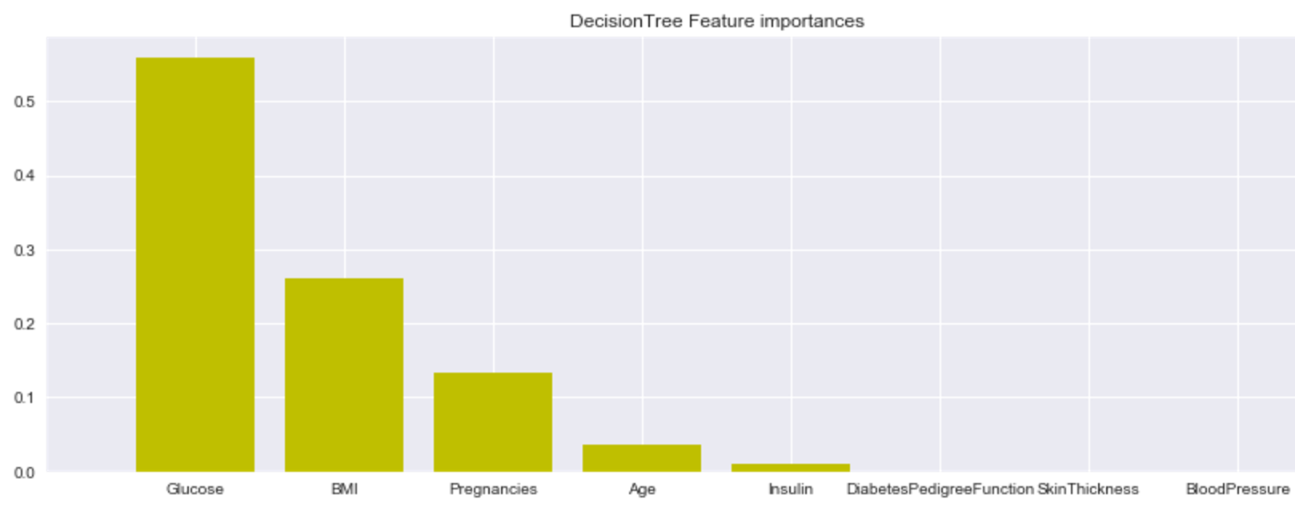
EVALUATION
Feature Importance
🠶 With the help of decision tree, we were able to figure out which features played an important role.
🠶 This graph depicts the highest importance features.
Decision Tree Feature Ranking
1. | Glucose | 0.558787
2. | BMI | 0.260081
3. | Pregnancies | 0.134401
4. | Age | 0.036539
5. | Insulin | 0.010191
6. | Diabetes Pedigree Function | 0.000000
7. | Skin Thickness | 0.000000
8. | Blood Pressure | 0.000000

Slide 25
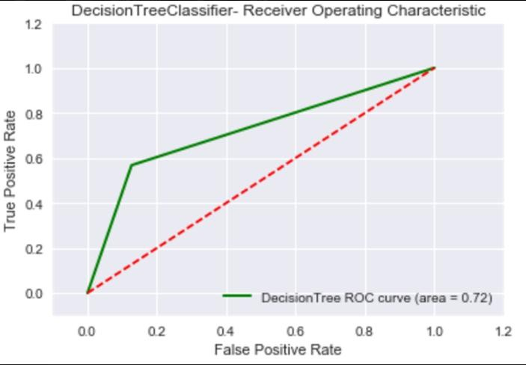
EVALUATION
ROC CURVE
The green line depicts Decision Tree curve area which is 0.72.
The dashed line in the diagonal represents the ROC curve of a random predictor. The random predictor is commonly used as a baseline to see whether the model is useful or not.

Slide 26
EVALUATION
The graph is called a Receiver Operating Characteristic curve (or ROC curve.) It is a plot of the true positive rate against the false positive rate for the different points.
It shows the tradeoff between True Positive Rate (TPR) and False Positive Rate (FPR) (any increase in (TPR) will be accompanied by a decrease in (FPR)).
The closer the curve towards TPR of the ROC space, the more accurate the test.
The closer the curve towards the FPR of the ROC space, the less accurate the test.
The Area Under the Curve (AUC) is a measure to determine the model effectiveness. The more AUC for a model comes to 1, the better it is. So models with higher AUCs are preferred over those with lower AUCs.

Slide 27
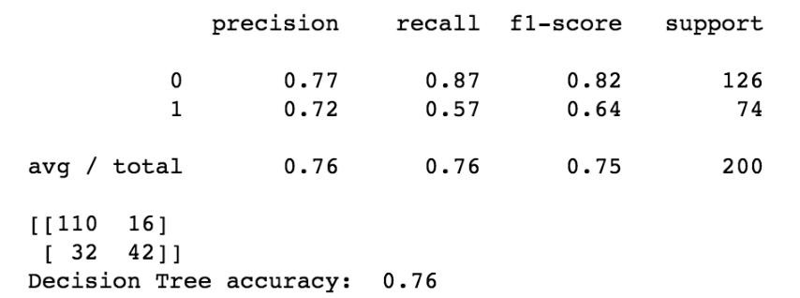
EVALUATION
CONFUSION MATRIX
true positives (TP): These are cases in which we correctly predicted diabetes as result.
true negatives (TN): We correctly predicted no diabetes and they don't have the disease.
false positives (FP): We correctly predicted no diabetes, but they actually had the disease. (Also known as a "Type I error.")
false negatives (FN): We correctly predicted diabetes, but they actually
had no disease. (Also known as a "Type II error.")
 | Predicted Yes | Predicted No
Actual Yes | tp (true positive) | fp (false positive)
Actual No | fn (false negative) | tn (true negative)
Confusion Matrix for the Decision Tree
Accuracy = tp + tn
tp+tn+fp+fn Precision = tp
tp+fp
Recall = tp
tp+fn
 | Predicted Diabetes | Predicted No Diabetes
Actual Diabetes | 110 | 16
Actual No Diabetes | 32 | 42
The Accuracy for the Decision Tree is 76%

Slide 28
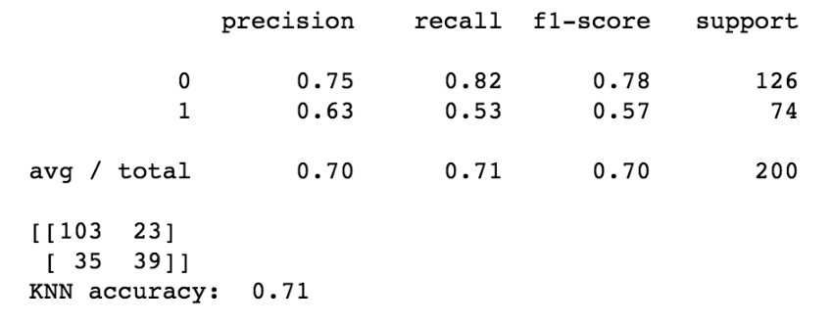
ALTERNATE MODEL COMPARISON
🠶 We tried another machine learning algorithm to compare the accuracy of the model.
🠶 We used K-Nearest Neighbor algorithm. The results obtained are as under:
Confusion Matrix KNN
Confusion Matrix Decision Tree
 | Predicted Diabetes | Predicted No Diabetes
Actual Diabetes | 103 | 23
Actual No Diabetes | 35 | 39
 | Predicted Diabetes | Predicted No Diabetes
Actual Diabetes | 110 | 16
Actual No Diabetes | 32 | 42
The Accuracy of Decision Tree is 76%.
The Accuracy of KNN Model is 71%

Slide 29
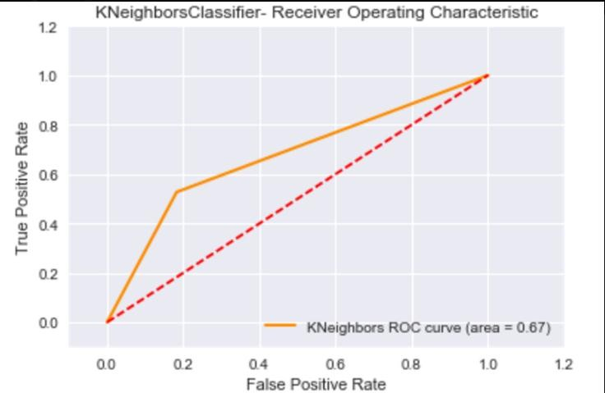
ALTERNATE MODEL COMPARISON
The Area Under Curve(AUC) for KNN is 0.67.
The Area Under Curve(AUC) for Decision Tree is 0.72.
So by comparing both the results we infer that Decision Tree Model is showing better results in comparison to K-Nearest Neighbor Model.

Slide 30
DEPLOYMENT
🠶 This is the last and the final phase of CRISP DM process. Deployment includes three important task :
🠶 Plan Deployment – Planning basically includes the strategy to be formulated for implementing the model in real world. This model can now be used in medical organizations for easy and early detection of diabetes in patients.
🠶 Monitor Deployment – In this, continuous monitoring of model takes place.
Regular check is done to ensure model is working fine and if any error occurs can be easily detected.
🠶 Generate Reports – Final statistical reports are generated which summarizes
the overall performance of the model.

Slide 31
CONCLUSION
🠶 The Decision Tree Model achieved 76% accuracy.
🠶 Different options were taken into consideration to improve the accuracy. So finally by removing outliers, categorizing data, keeping tree depth to 4 we were able to achieve desired accuracy.
🠶 During this process we figured out few attributes that played an important role . Out of eight attributes Glucose, BMI, Pregnancies, Age and Insulin were the important ones. As per our results and data the other factors like Diabetes Pedigree Function, Skin Thickness and Blood Pressure had negligible effect in determining diabetes.
🠶 We even compared our CART model with K-Nearest Model and inferred that CART is the best amongst the two.

Slide 32
REFERENCE
🠶 http://archive.ics.uci.edu/ml/
🠶 Discovering Knowledge in Data: An Introduction to Data Mining, By Daniel
T. Larose
🠶 Slides & Lecture Notes
🠶 http://scikit-learn.org/stable/
🠶 http://pandas.pydata.org/

Slide 33
THANK YOU

